Slide 1


EV Battery Thermal Runaway Early Detection
STM32 based monitoring system, simulated in Proteus
PIXEL PIRATES |30/10/26
Notes:
Intro (1 min): state the problem and why early detection matters.

Slide 2
The Problem
Thermal runaway is a chain reaction: heat from a failing cell releases more heat, and the rise gets faster and faster
Safe cell range is roughly 15 to 45 °C; internal breakdown can begin around 80 °C and above
One faulty cell can heat its neighbours, so a small fault can become a full pack fire
Causes: internal short circuit, overcharge, fast-charging heat, crash damage, cooling failure
Today most systems use only a fixed temperature limit, which reacts late and can miss a hot spot in one cell
Notes:
A simple threshold is not enough: by the time it trips, the cell may already be past recovery. Temperature changes slowly, but a fast rise or a current spike appears earlier.

Slide 3
System Architecture
Inputs (Simulated)
RV1-RV3: cell temperature
RV4: battery current
STM32F401RE
ADC sampling
Gradient + spike
risk logic
Local Outputs
16x2 LCD status
Green / Yellow / Red LEDs
→
→
Potentiometers stand in for real sensors, so the full detection logic can be tested safely without a physical battery.
The same ADC code will work later with real NTC and current sensors.
Next phase: STM32 sends data to an ESP32 over UART, which publishes over Wi-Fi (MQTT) to the cloud dashboard.
Notes:
Left to right: simulated sensor inputs, STM32 processing, local outputs. Cloud is the next phase. Architecture (1 min).

Slide 4
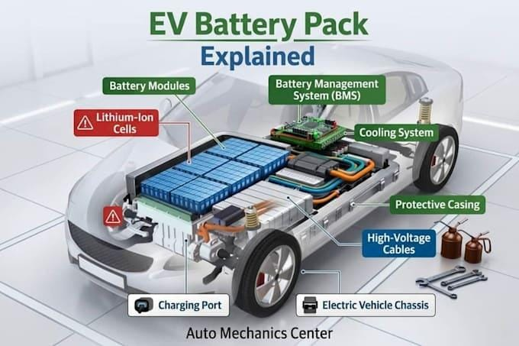

Slide 5
Implementation (Proteus Simulation)
Microcontroller: STM32F401RE reads the inputs through its ADC pins
10k potentiometers on a 3.3 V supply emulate temperature and current sensor voltages
Firmware computes temperature change rate and sudden current jumps in real time
Readings are filtered and checked over several samples in a row to avoid false alarms
16x2 LCD shows battery status; Green, Yellow and Red LEDs (330 ohm) show the risk level
Notes:
Turning a potentiometer knob during simulation is the same as the sensor value changing in a real pack. A simulation is also safer for testing fault cases.

Slide 6
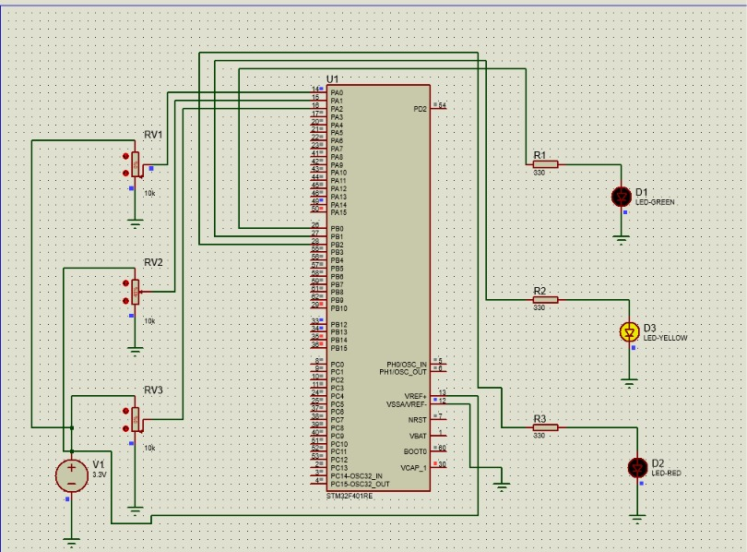

Slide 7
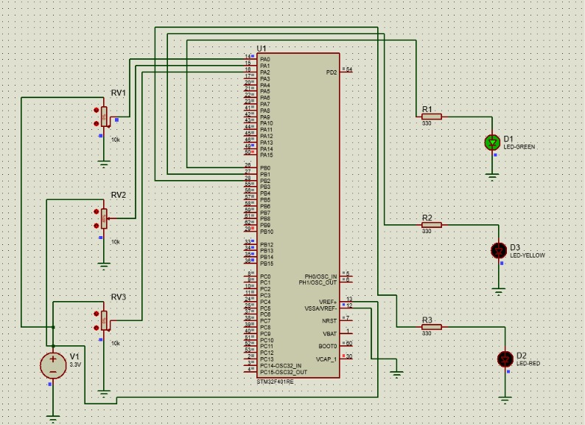

Slide 8
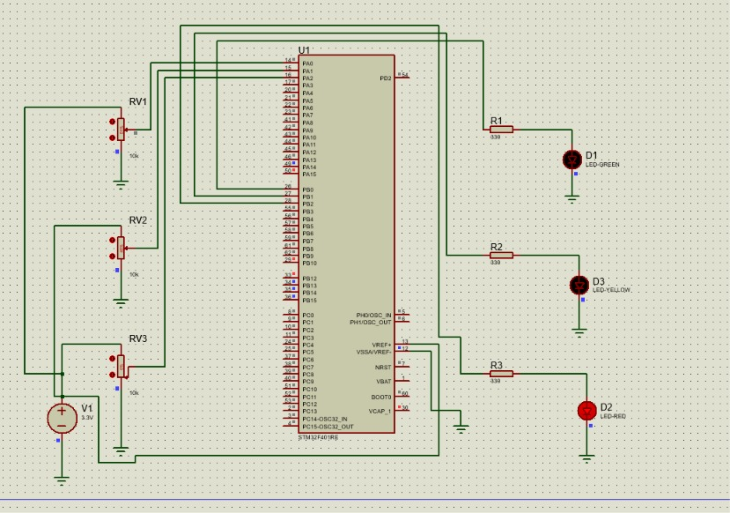

Slide 9
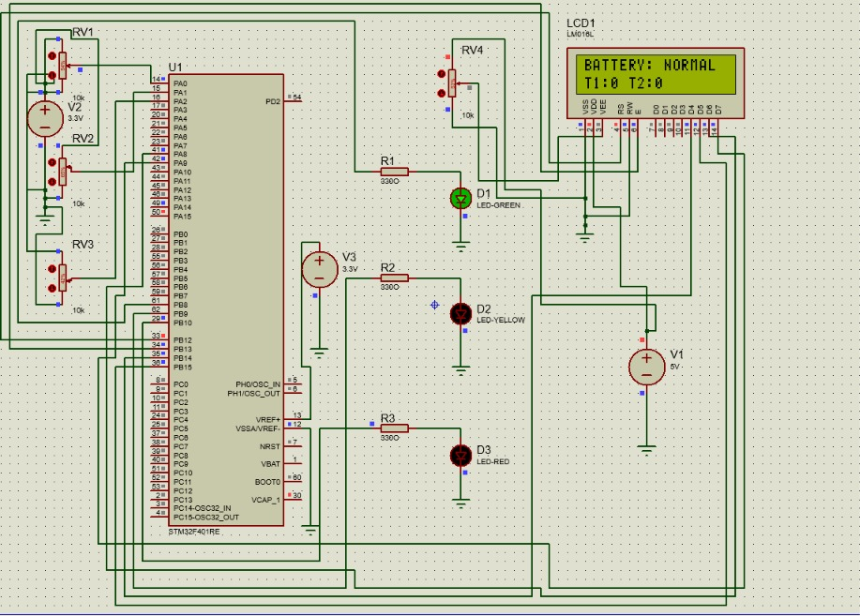

Slide 10
Risk Prediction Logic
Parameter | Normal | Warning | Critical
Temperature | below 45 °C | 45 to 60 °C | above 60 °C
Gradient (dT/dt) | below 1 °C/min | 1 to 3 °C/min | above 3 °C/min
Current spike | normal load | moderate jump | very large jump
Output | Green LED | Yellow LED | Red LED
High gradient + current spike together goes straight to Critical, even if temperature is still low
A state changes only after several consecutive samples agree, to avoid false alarms
Critical in a real vehicle also triggers a buzzer and contactor cut-off
Notes:
Walk through the table. Key point: high gradient together with a current spike goes straight to Critical even if the temperature is still low. This is the early-detection part. Threshold values are example values tuned for the simulation. Pseudocode: read T1,T2,T3,I; gradient=(T_now-T_prev)/dt; spike=(I_now-I_prev)>spike_limit; if T>60 or gradient>3 or (gradient>1 and spike) -> CRITICAL (Red); else if T>45 or gradient>1 or spike -> WARNING (Yellow); else NORMAL (Green).

Slide 11
Live Demo & Results
Start the simulation at Normal: LCD shows battery normal, Green LED on
Raise a temperature potentiometer slowly: Yellow LED (Warning)
Raise temperature fast and create a current spike: Red LED (Critical)
Result: the system warns on the rate of rise and the spike, before the fixed limit is reached
Extra safety: local LCD and LED alerts work even without a network
Limitation: simulation only so far; thresholds need tuning with real cell test data
Add your own observed values and Proteus screenshots of each state
Notes:
Demo script (5 to 10 min): Intro 1 min, Architecture 1 min, Normal state 1 min, Slow heating 2 min, Fault case 2 min, Close with results, limitations and roadmap 1 min. Add clean Proteus screenshots of Normal, Warning and Critical.

Slide 12
Deployment Roadmap
Phase 1 (done): Proteus simulation with STM32, LCD and LED alerts
Phase 2: hardware prototype with real NTC sensors and a Hall-effect current sensor, plus buzzer and relay cut-off
Phase 3: ESP32 + MQTT cloud dashboard with live graphs, risk level and SMS/email alerts
Phase 4: CAN bus integration with the BMS, machine learning on real battery data, voltage and gas sensing
Impact: earlier warnings, safer EVs, lower fire risk
Notes:
Be clear that the cloud dashboard is planned work; the simulation covers sensing, detection and local alerts. Likely questions: Why not just a temperature limit? A limit reacts late; gradient and spike warn earlier. Why potentiometers? They simulate sensor voltage, the same ADC code works with real sensors, and fault testing is safer. How is it different from a BMS? It can be added to a BMS; the focus is early prediction, not just limit protection.

